Slide 1
Sentiment Analysis on Yelp Review Dataset Using Transformer Model
CSCE 633 Final Project
Manoj Kumar Reddy Peta
UIN: 934008522

Slide 2
Introduction
1. Evolution of Text Classification Methods:
NLP has evolved from niche to essential, with sentiment analysis gaining prominence in various applications.
The shift from manual feature engineering to deep learning models like LSTMs and CNNs allowed for improved accuracy in sentiment detection from large-scale data.
2. Introduction of Transformer Models:
The emergence of the Transformer architecture has redefined benchmarks in NLP.
Its self-attention mechanism processes words in parallel, offering a significant efficiency boost over sequential word processing.
3. Advancements Brought by Transformers:
Transformers address the limitations of previous models by evaluating the importance of each word without the constraints of word order.
This leads to a deeper contextual understanding, critical for accurate sentiment analysis.
4. Project Focus:
This project explores the application of Transformer models to perform sentiment analysis on the Yelp review dataset.
I experimented with varying the model's architecture to optimize performance across diverse sentiment expressions.

Slide 3
Related Work and Review of State of Art
Related Work
The landmark paper "Attention Is All You Need" by Vaswani et al. introduced the Transformer model, revolutionizing NLP by replacing recurrent layers with self-attention mechanisms.
This shift marked a significant departure from conventional approaches, enabling models to process data in parallel and capture long-range dependencies more effectively.
Other previous works involved Recurrent Neural Networks (RNNs), including their Long Short-Term Memory (LSTM) variants, have been foundational in NLP for their ability to process sequential data and capture dependencies. Despite their success, RNNs and LSTMs often struggle with long-range dependencies, a limitation addressed by the Transformer architecture
Current State of the Art in Sentiment Analysis and Text Classification:
In the realm of sentiment analysis and text classification, Transformer-based models like GPT-3, BERT, and XLNet represent the current state of the art.
These models, characterized by their vast numbers of parameters and large-scale pre-training, have significantly advanced the field. They excel in understanding complex language structures and nuances, thereby achieving unparalleled performance across a variety of NLP tasks
Their adaptability, seen through methods like fine-tuning and prompt-tuning, allows for exceptional accuracy and nuanced context interpretation in diverse NLP challenges.

Slide 4
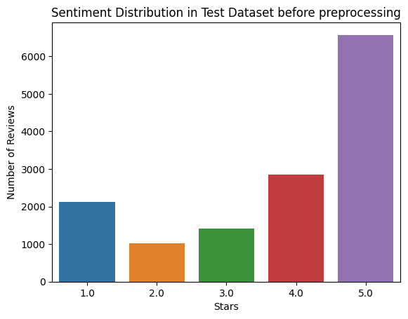
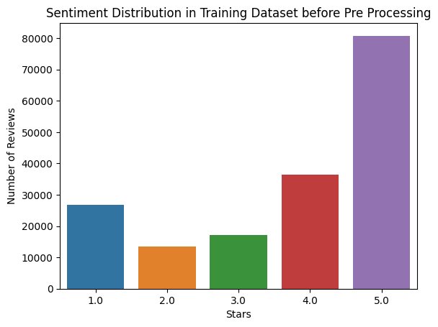
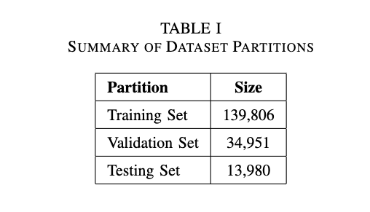
Dataset
For the sentiment analysis, a subset of the Yelp review dataset is used.
A training data subset of 174,757 reviews is used, each conjoined with a star rating reflecting the sentiment of the customer experience.
A validation split of 20% is made.
The testing set consists of 13,980 instances.
The average review is 356.58 tokens long in the training data, while the longest review is 3,619 tokens. This is later used for choosing maximum sequence length.

Slide 5
Preprocessing
Data Preprocessing
Converting stars to sentiment — The dataset's 'review' and 'stars' features were transformed into categorical sentiments—'Positive' for above 3 stars, 'Negative' for 2 or fewer, and 'Neutral' for 3 stars—simplifying the model's output for standard sentiment analysis.
Text Normalization
Punctuation Removal
Lowercasing
Stop Word Removal — Commonly used words (stop words) that do not contribute significantly to the sentiment of the text were removed. This step was performed using the NLTK library, which provides a comprehensive list of English stop words.
Label Encoding — The transformed sentiment labels were then encoded into a numerical format suitable for machine learning algorithms.
Input Data Preparation
Word Count Distribution — This analysis was crucial not only to identify the most commonly used words but also to inform the creation of a dictionary representing our vocabulary.
Text Vectorization — utilized the TextVectorization layer from TensorFlow’s Keras API for this purpose.
The configuration for the vectorization was as follows:
Maximum Tokens — 30,000
Output Mode — int
Output Sequence Length — 500
Standardization — Nonf
This vectorization process transformed the textual data into a numerical format, making it suitable for input into our machine learning mode

Slide 6
Transformer Implementation
Positional Embedding Layer
It converts input tokens (words or subwords) into dense vectors of a specified size.
It adds positional information to these token embeddings essential for maintaining the sequence order, as the Transformer architecture does not inherently capture sequential data’s temporal aspects. This is called positional embedding.
This layer outputs a combination of token and position embeddings, forming the initial representation of the input text.
Transformer Encoder Layer
The main building block of our model is a custom ‘TransformerEncoder‘ layer, structured as follows:
A Multi-Head Attention mechanism
A feed-forward neural network
Layer Normalization steps, applied after both the attention mechanism and the dense layers.
Residual connections, a standard practice in deep learning architectures.
Model Architecture and Training
The input text, represented as sequences of integers, passes through the ‘PositionalEmbedding‘ layer.
Multiple ‘TransformerEncoder‘ layers process the embedded input sequentially.
A Global Average Pooling layer follows, reducing the dimensionality and summarizing the important features.
Dropout layers are applied for regularization.
A final dense layer with a softmax activation function outputs.

Slide 7
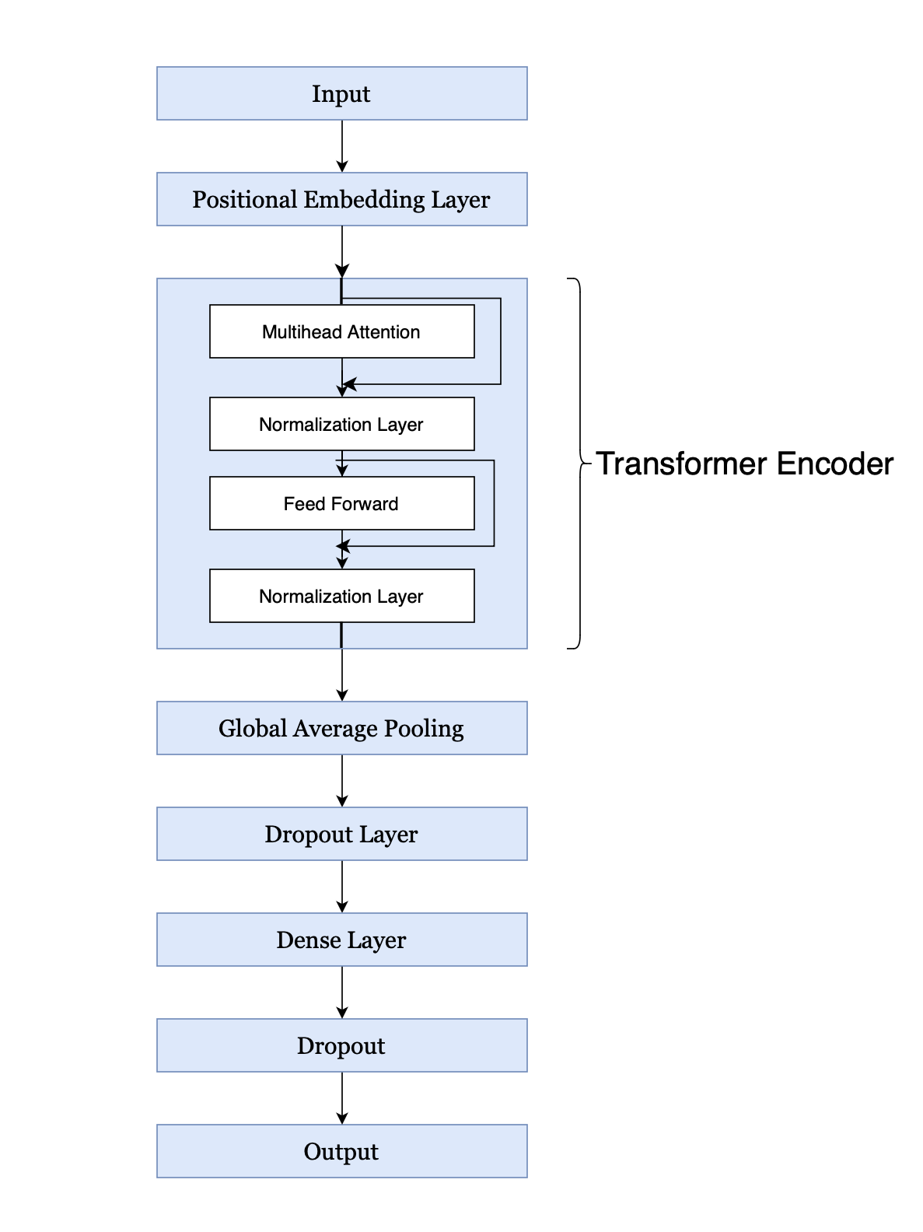
Transformer Architecture

Slide 8
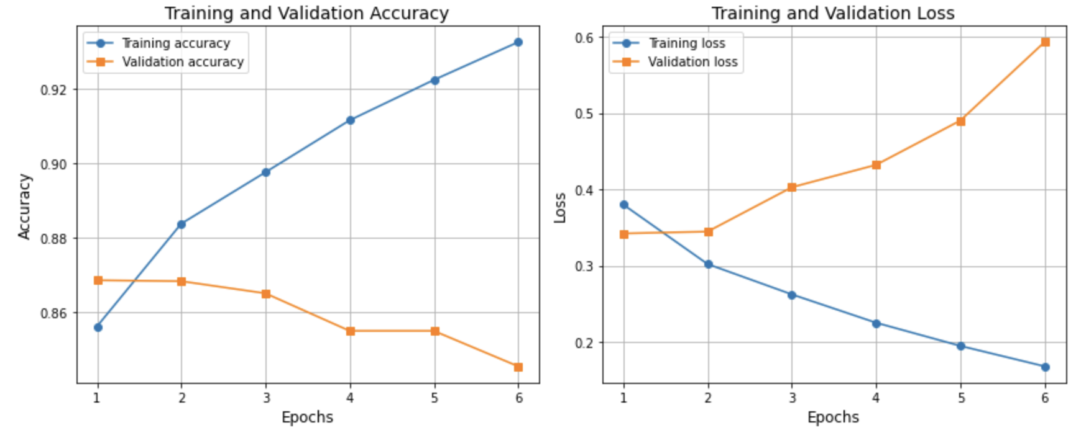
Configuration 1
Encoder Layers: 1
Embedding Dimension: 32
Number of Attention Heads: 2
Latent Dimension: 32
Dropout: 0.1

Slide 9
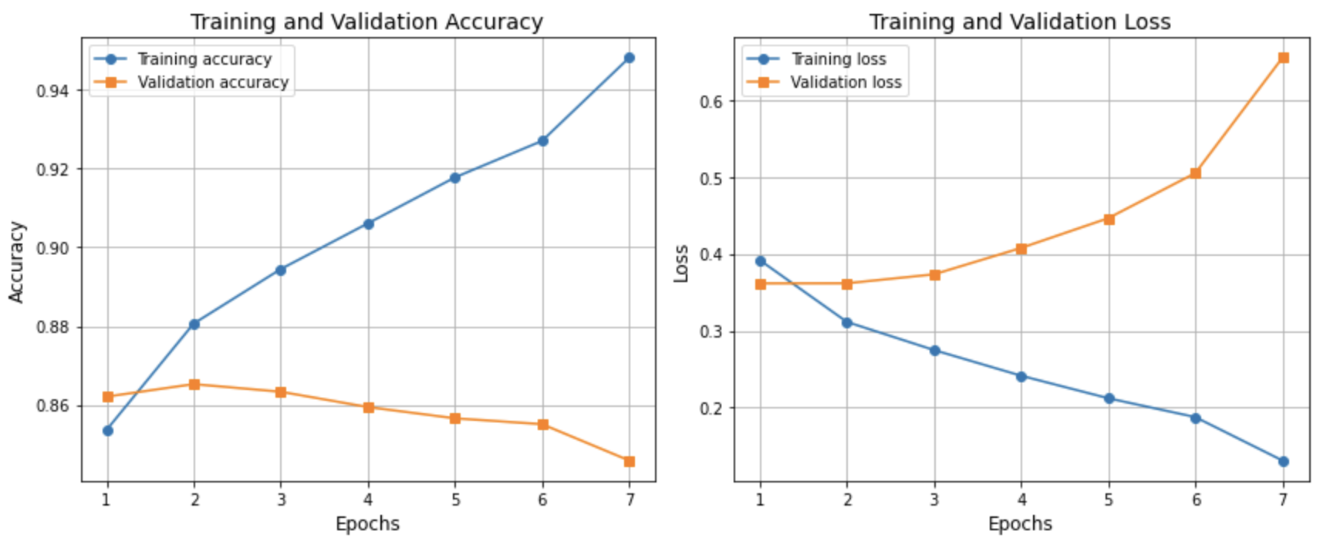
Configuration 2
Encoder Layers: 2
Embedding Dimension: 64
Number of Attention Heads: 4
Latent Dimension: 64
Dropout: 0.2

Slide 10
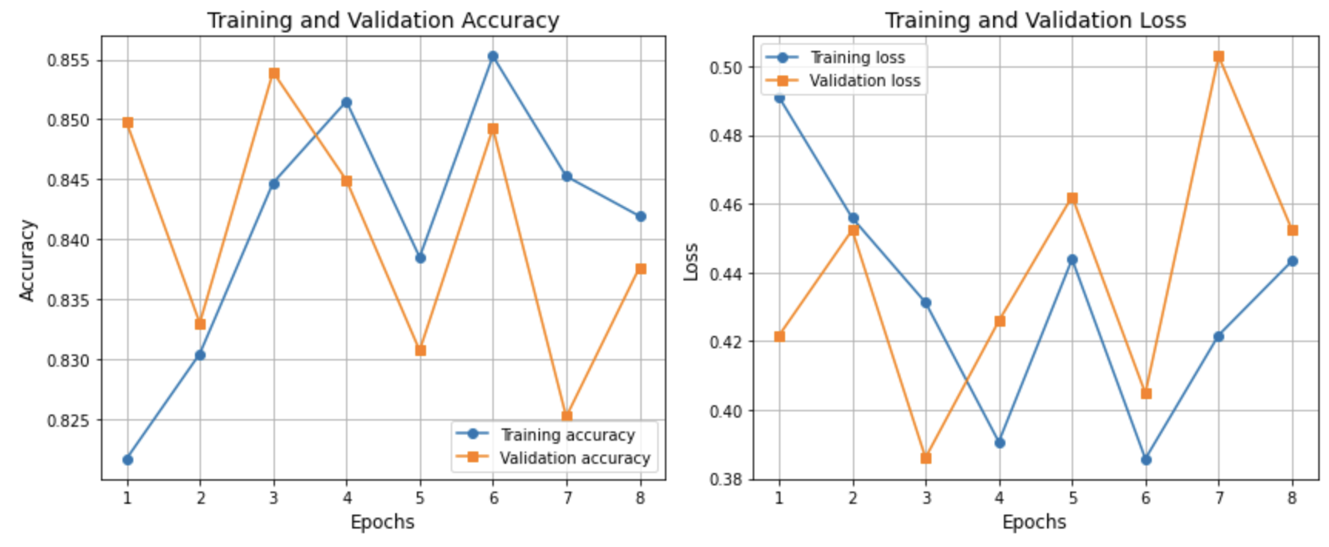
Configuration 3
Encoder Layers: 3
Embedding Dimension: 128
Number of Attention Heads: 6
Latent Dimension: 128
Dropout: 0.3

Slide 11
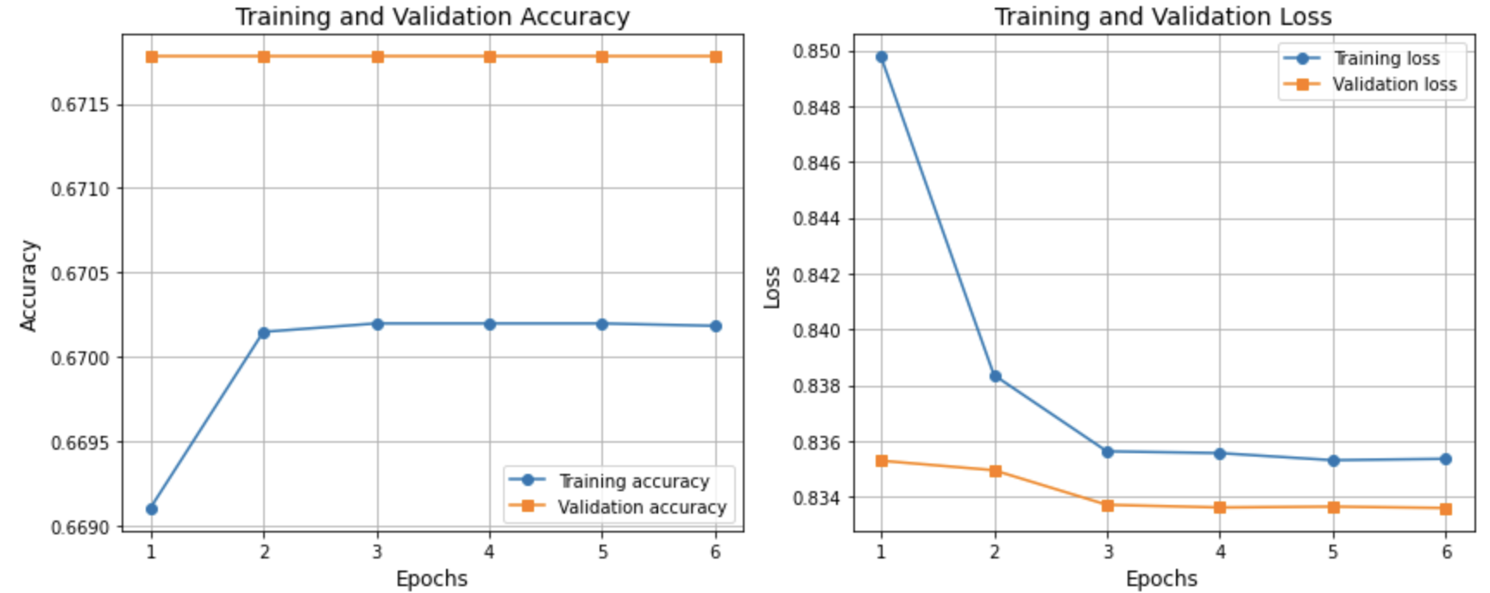
Configuration 4
Encoder Layers: 4
Embedding Dimension: 256
Number of Attention Heads: 8
Latent Dimension: 256
Dropout: 0.4

Slide 12
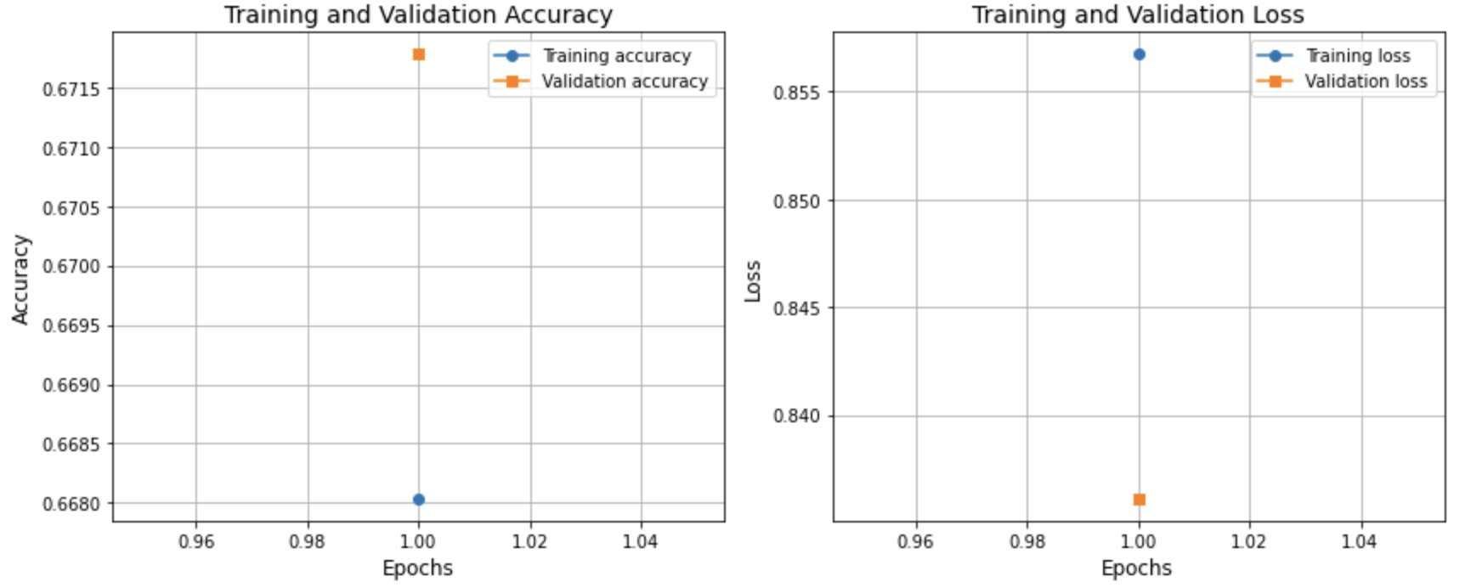
Configuration 5
Encoder Layers: 5
Embedding Dimension: 512
Number of Attention Heads: 10
Latent Dimension: 512
Dropout: 0.5

Slide 13
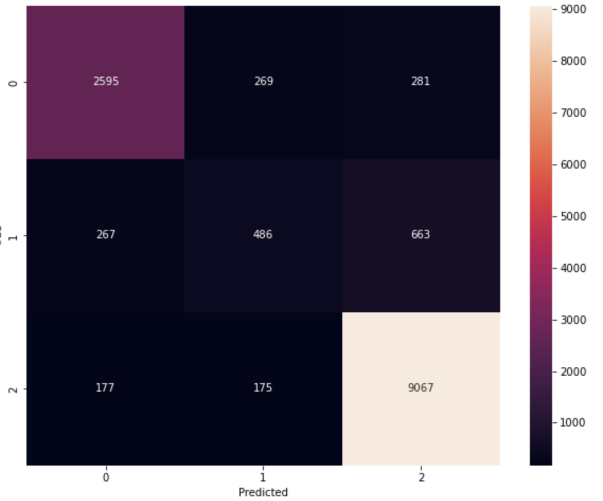
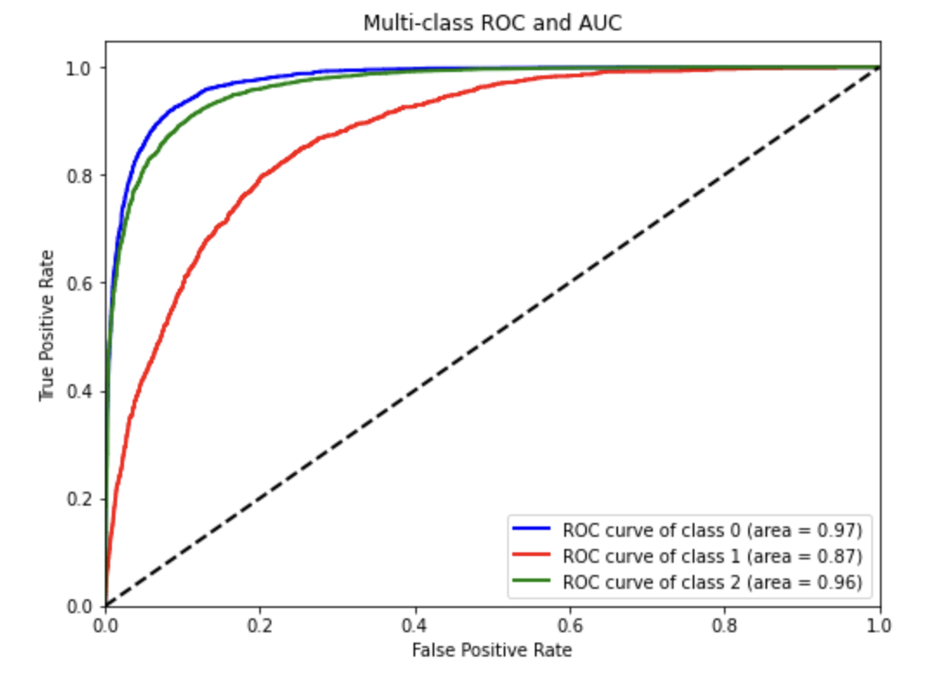
Results for Test Data
From the results discussed in previous section, it be seen that configuration 1 performs the best among all the configurations considered. Upon using this model on testing data, an accuracy of 86.90% is obtained.

Slide 14
THANK YOU

Slide 15
The End!

